Slide 1


CS214 – Data Structures
Lecture 15: Trees III
Slides by
Mohamed El-Ramly, PhD
Basheer Youssef , PhD
Notes:
Polls in slides:
in lecture 1: 24,29,31,32,42,46
in lecture 2: 65,84,102,103,108,117,130

Slide 2
Agenda
  Introduction to Binary Trees
  Implementing Binary Trees
  Searching Binary Search Trees
  Tree Traversal …1. Breadth-First ….2. Depth-First
  Insertion
  Deletion by Copying
  Balanced Trees
  Heaps / Heap Sort

Slide 3
6.6 Deletion from a BST
Deletion is a third important operation after search and insert.
Its difficulty depends on the position of the node to delete.

Slide 4
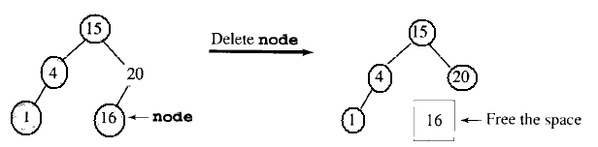
6.6 Deletion from a BST
Deleting a leaf is easy

Slide 5
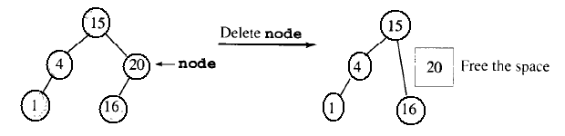
6.6 Deletion from a BST
2. Deleting a node with one child is easy. The link will go directly to the child node.

Slide 6
6.6 Deletion from a BST
3. Deleting a node with two children. There is no one-step operation to do it.

Slide 7
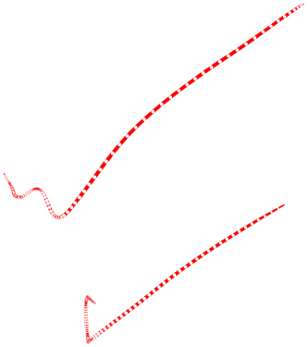
Deletion by Copying
If the node is a leaf, replace it with null.
If the node has one child, make its parent connect to its child and remove the node.
If the node has two children
  Get its predecessor or successor
    Get the right most node in the left tree nleft or
    Get the left most node in the right tree nright
  Copy the key in nleft or nright to the node to be deleted
  Remove nleft or nright as in 1 or 2 above

Slide 8
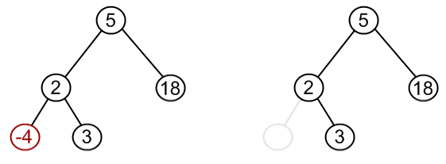
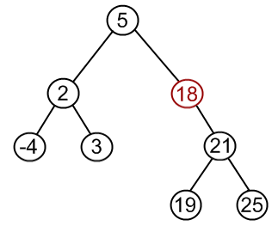
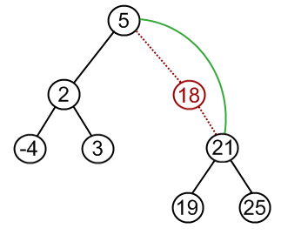
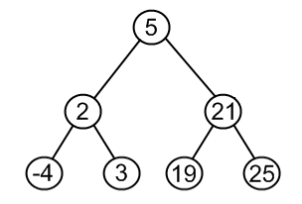

Slide 9
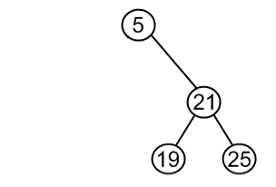
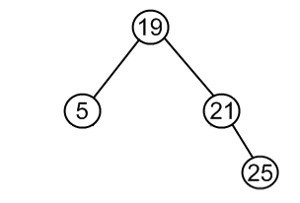
The same approach can be utilized to remove a node, which has two children:
find a minimum value in the right subtree;
replace value of the node to be removed with found minimum.
Now, right subtree contains a duplicate!
apply remove to the right subtree to remove a duplicate.
Notice, that the node with minimum value has no left child and,
therefore, it's removal may result in first or second cases only.

Slide 10
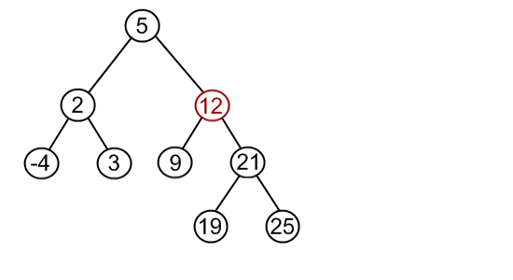
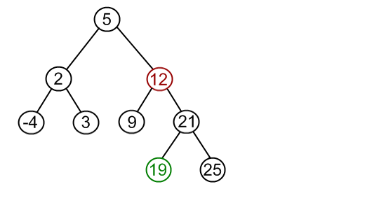
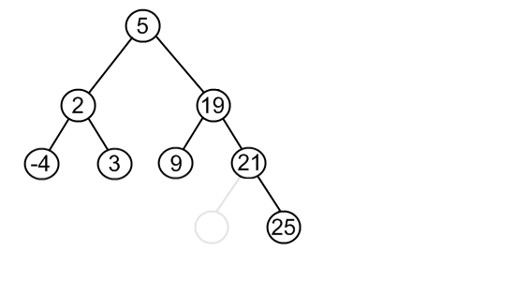
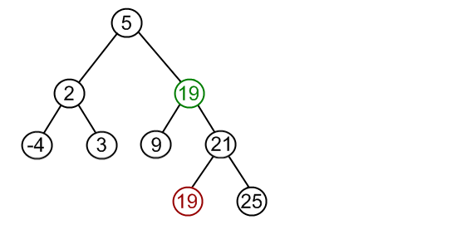
Remove 12 from a BST.
Find minimum element in the right subtree of the node to be removed.
Replace 12 with 19. Notice, that only values are replaced, not nodes.
Remove 19 from the left subtree.

Slide 11
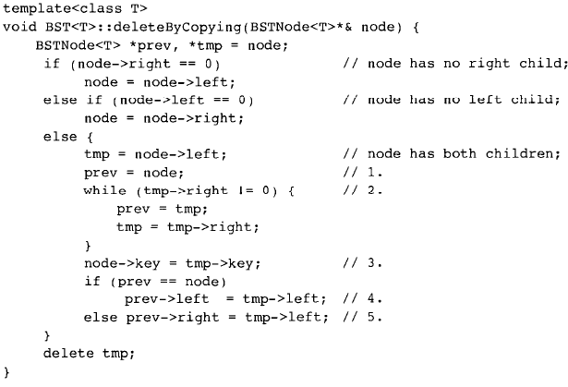

Slide 12
6.7 Tree Balancing
The disadvantage of a binary search tree is that its height can be as large as n-1.
This means that the time needed to perform insertion and deletion and many other operations can be O(n) in the worst case
We want a tree with small height

Slide 13
6.7 Tree Balancing
A binary tree with n node has height at least Θ(log n)
Thus, our goal is to keep the height of a binary search tree O(log n)
Such trees are called balanced binary search trees. Examples are AVL tree, red-black tree.

Slide 14
6.7 Tree Balancing
A balanced tree is one who has the difference in height of both subtrees of any node in the tree is either one or zero.
A perfectly balanced tree is one who is balanced and has all the leaves at the same level.

Slide 15
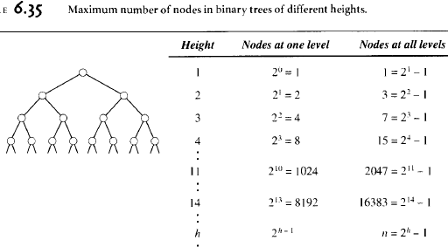

Slide 16
6.7 Tree Balancing
Technique 1: Continuously restructure the tree when new elements arrive that cause imbalance in the tree. So, we always keep the tree balanced. (AVL, DSW)
Technique 2: Reorder the data and then build the tree so that it is balanced.

